Slide 1
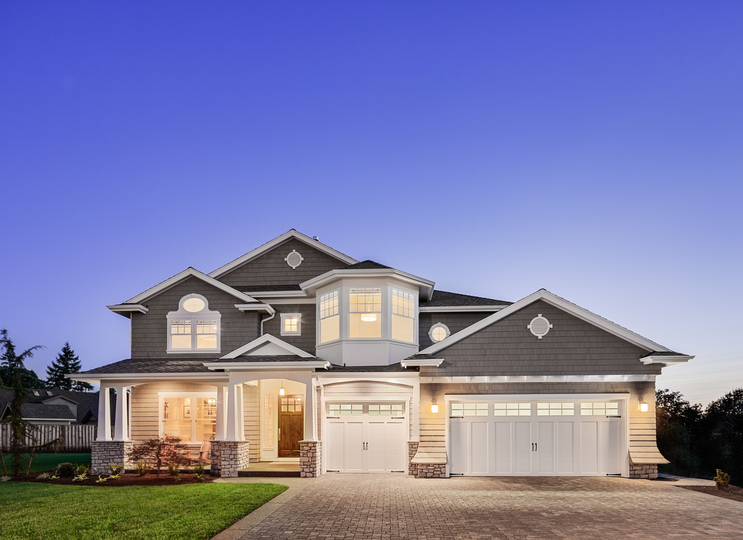
Zillow 2016 Kaggle Competition
Drew Gandham, Eli Clizbe, Will Michael, Andrew McGrady

Slide 2
Agenda
Problem Statement
Critiques of Kaggle Submissions
Models Experimentation Review
Best Model/Important Predictors
Conclusion
Notes:
Lasso and Ridge basically reduced all the coefficients to 0

Slide 3
Problem Statement
Problem Statement
Critiques of Kaggle Submissions
Models Experimentation Review
Best Model/Important Predictors
Conclusion
Notes:
Lasso and Ridge basically reduced all the coefficients to 0

Slide 4
Problem Statement
To create an algorithm to predict the prices of homes in Los Angeles, Orange and Ventura County
Specifically predict the log-error between Zestimate and actual sale price given all features of a home

Slide 5
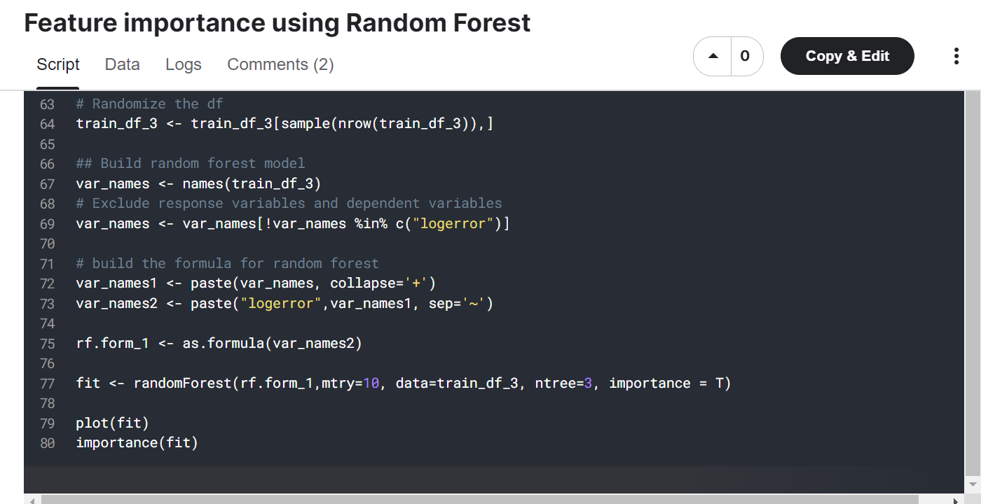
Critiques of Past Solutions
Random Forest - small number of trees bad!
Notes:
https://www.kaggle.com/code/lakshaykc/feature-importance-using-random-forest

Slide 6
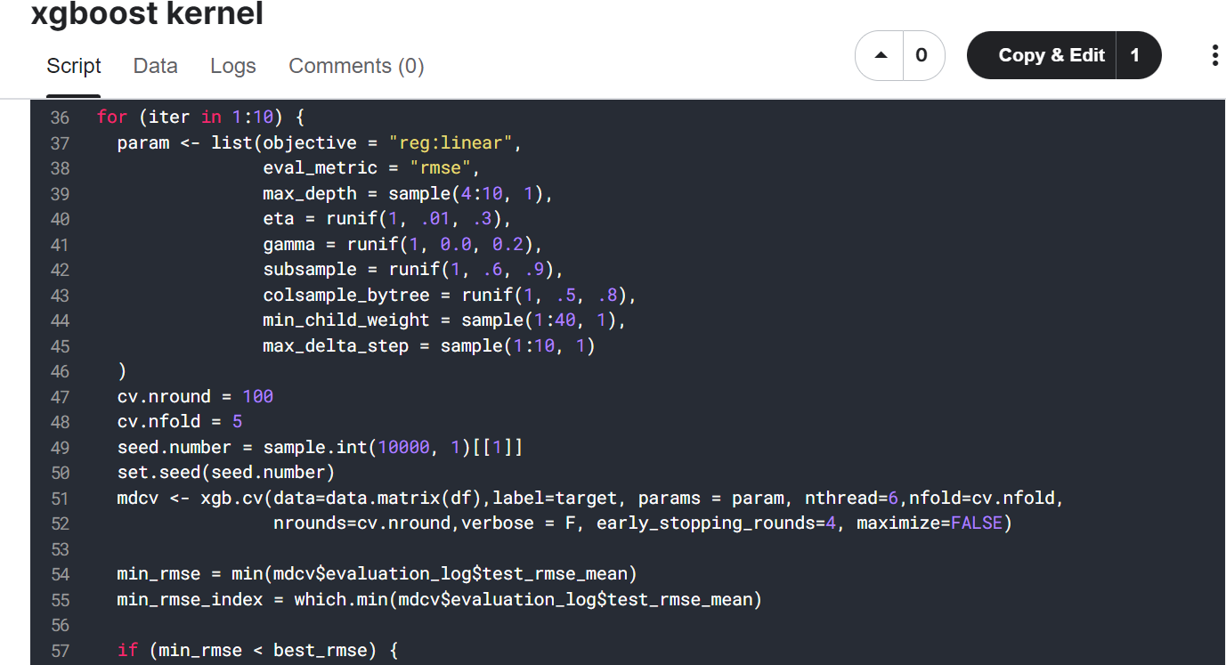
Critiques of Past Solutions
Xgboost - random selection not repeatable
Notes:
Fully randomly selected .. everything!
https://www.kaggle.com/code/elpidiofilho/xgboost-kernel

Slide 7
Model Experimentation
Best Subset (Forward and Backwards)
Too many linearly dependent variables
Lasso/Ridge
Made intercept-only models
Random Forest
Boosting & XGBoosting
Over to R!
Notes:
Lasso and Ridge basically reduced all the coefficients to 0

Slide 8
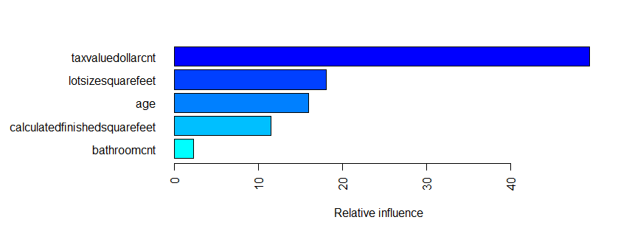
GBM Boosting: Important Predictors

Slide 9
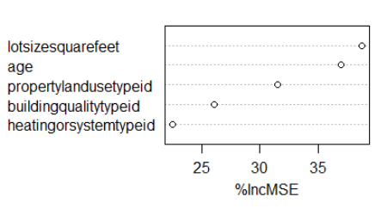
RF: Important Predictors

Slide 10
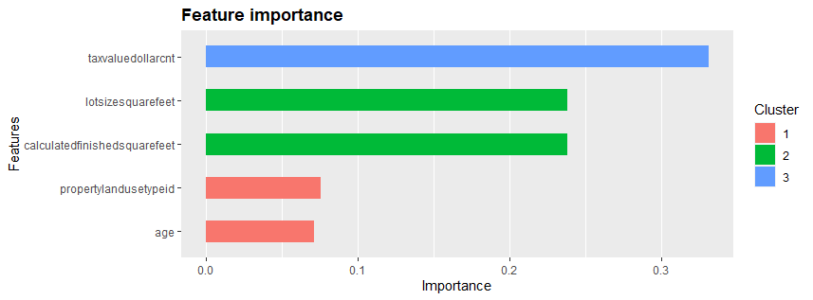
XGBoosting: Important Predictors

Slide 11
Conclusions
Best model: XGBoost (MSE: 0.0277)
Reason:
Lowest MSE
Computationally efficient
Easy to interpret
Issues:
Multicollinearity/Feature Selection - partly intuitive

